Slide 1
Laplace’s Equation in 2 and 3 Dimensions
Douglas Wilhelm Harder, M.Math. LEL
Department of Electrical and Computer Engineering
University of Waterloo
Waterloo, Ontario, Canada
ece.uwaterloo.ca
dwharder@alumni.uwaterloo.ca
© 2012 by Douglas Wilhelm Harder. Some rights reserved.

Slide 2
Outline
This topic discusses numerical solutions to Laplace’s equation in two and three dimensions
Discuss the physical problem and properties
Examine the equation
Consider boundary conditions in two and three dimensions
Approximate the equation using a finite-difference equation
This will define a system of linear equations

Slide 3
Outcomes Based Learning Objectives
By the end of this laboratory, you will:
Understand Laplace’s equation
Understand how to approximate the equation in two and three dimensions using finite-difference equations
You will understand how the solutions may be approximated using a system of linear equations

Slide 4
Motivating Example
Laplace’s equation is a simple statement of second partial derivatives
where u(x) is a function of n variables
We will consider n = 1, 2 and 3

Slide 5
Motivating Example
In one dimension, this simplifies to
where u(x) and the solution to any boundary-value problem is a straight line connecting the two end points

Slide 6
Motivating Example
If we are dealing with soap films, the force that exerted by the film is proportional to the concavity
With concentrations, thermal energy and electric potentials, for a system to be in steady state, the forces exerted by the second derivatives with respect to concentration, thermal energy and electric potentials must be zero and cancel

Slide 7
Motivating Example
In two and three dimensions, Laplace’s equation says that at each point, the sums of the concavities is zero
and

Slide 8

Motivating Example
If we are dealing with soap films, the force that is exerted by the film is proportional to the concavity
User:Rror

Slide 9
Motivating Example
If we are dealing with a concentration, the concentration at any point will be the average of the concentrations around it
In the steady state, we do not expect one point to be more concentrated than everything around it

Slide 10
Motivating Example
If we are dealing with a thermal energy, the thermal energy at any point will be the average of the thermal energy around it
We do not expect, in the steady state, the temperature at one point to be higher or lower than all the points in the immediate neighbourhood

Slide 11
Finite-Element Equation
So, given:
and
Let’s approximate these using the divided-difference approximations of the partial derivatives

Slide 12
Finite-Difference Equation
On substitution, we get:
Multiplying by h² and collecting like terms simplifies these…

Slide 13
Finite-Difference Equation
Solve for u(x, y) or u(x, y, z):
What do these approximations mean?

Slide 14
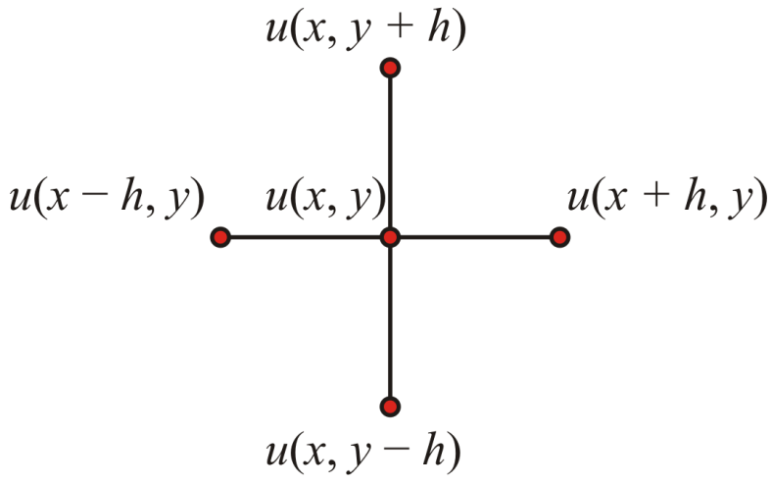
Finite-Difference Equation
In two dimensions,
says that the value of u(x, y) is average of the four points around it

Slide 15
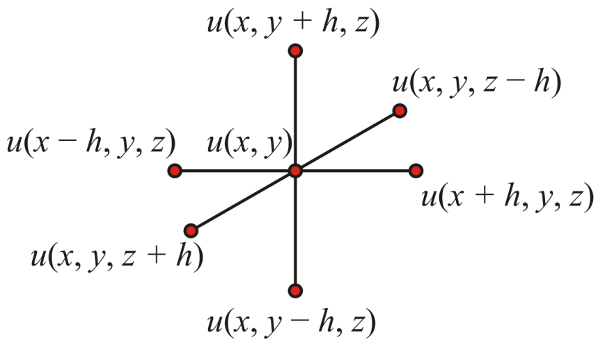
Finite-Difference Equation
In three dimensions,
says that the value of u(x, y , z) is average of the six points around it

Slide 16
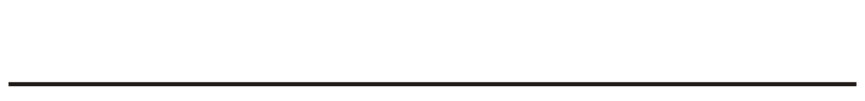
Boundary Values
In one dimension, we have the average of two values:
To satisfy the constraints, given the real line

Slide 17
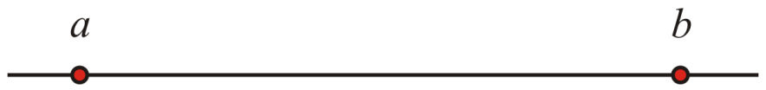
Boundary Values
In one dimension, we have the average of two values:
To satisfy the constraints, given the real line
we must specify the boundary values of a domain—in this case, an interval

Slide 18

Boundary Values
In two dimensions, we must evaluate the function in four directions
Given a plane,

Slide 19
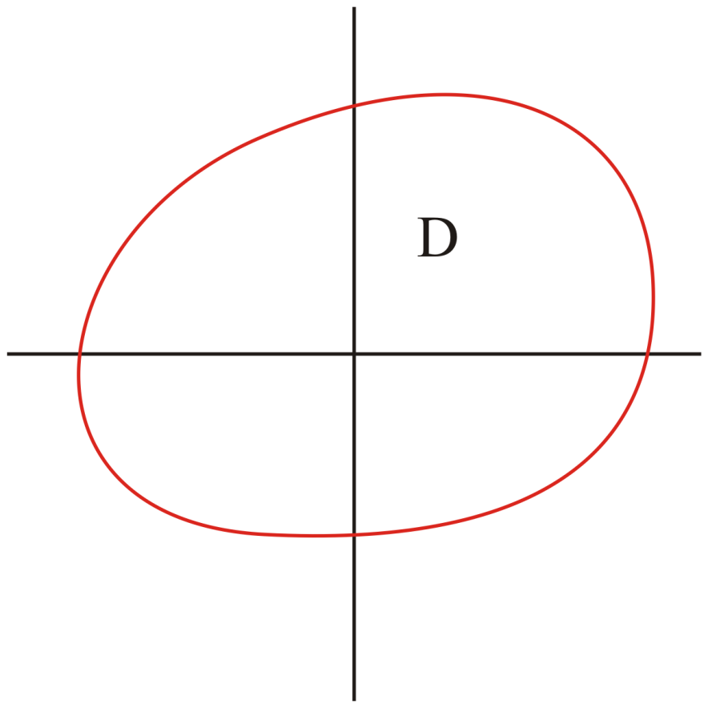
Boundary Values
In two dimensions, we must evaluate the function in four directions
Given a plane, we must specify an enclosed domain

Slide 20
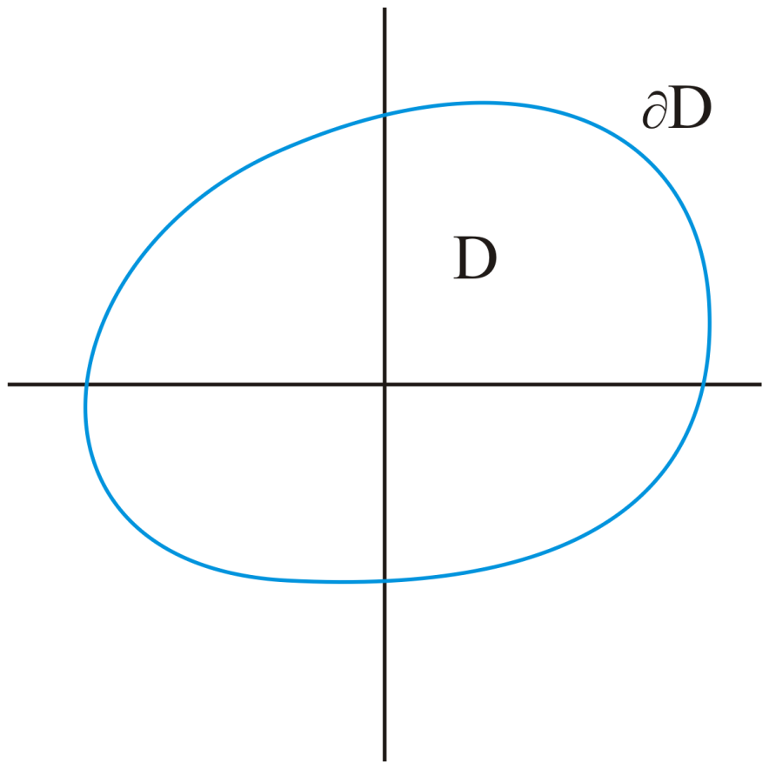
Boundary Values
In two dimensions, we must evaluate the function in four directions
The constraints must be defined along the entire boundary ∂D

Slide 21
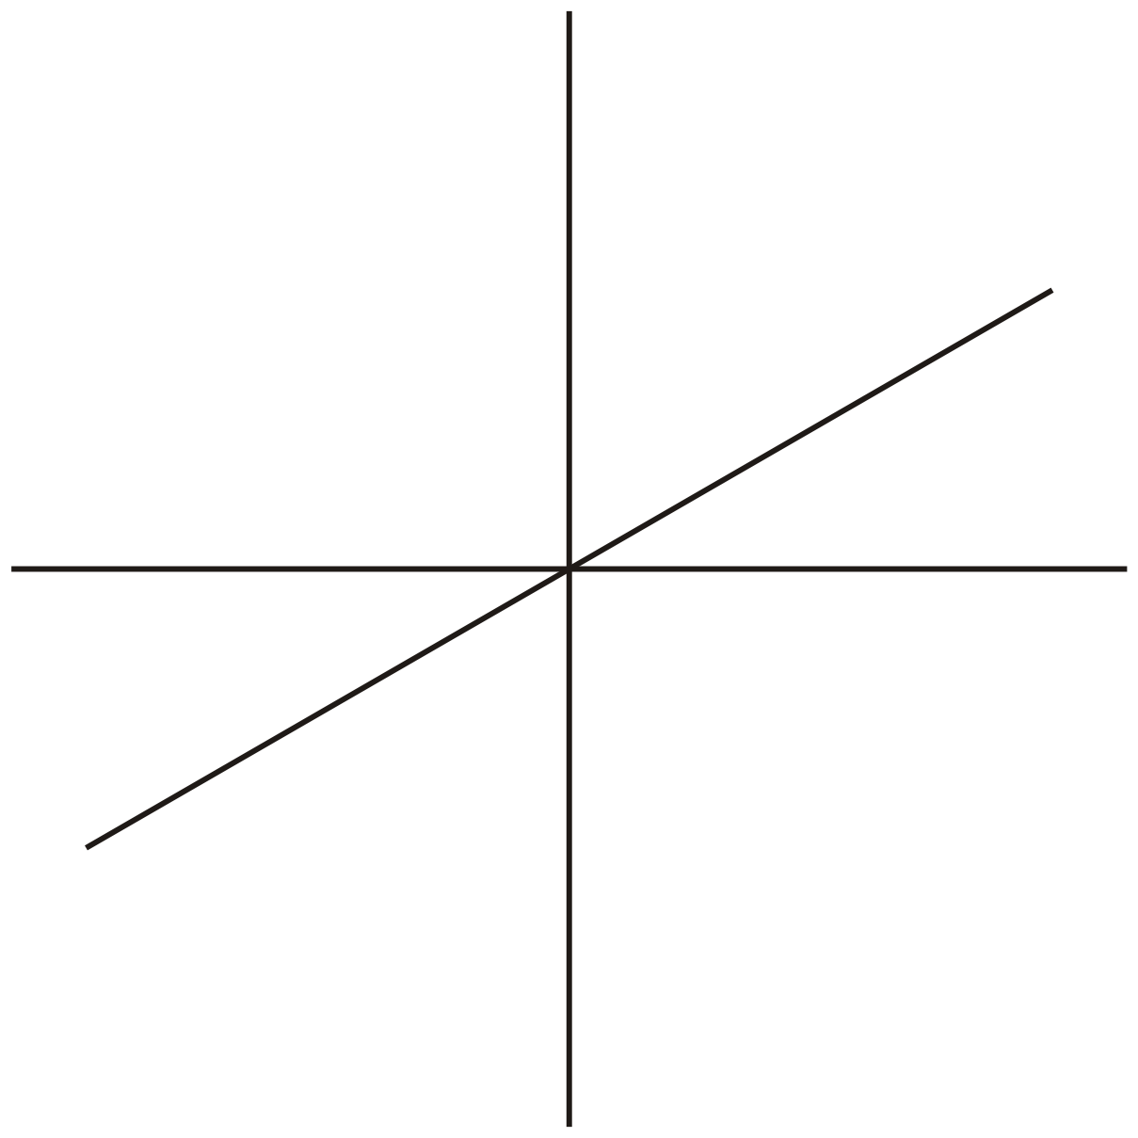
The Laplacian Operator
How about three dimensions?

Slide 22
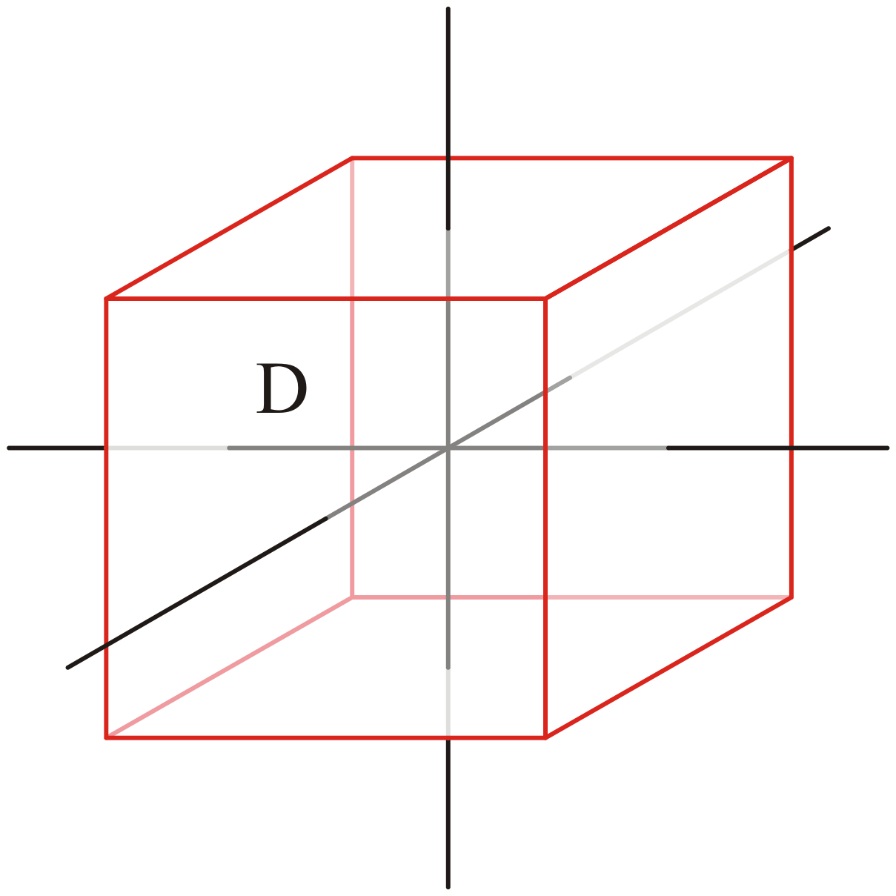
The Laplacian Operator
The domain D will have to be some volume in three space

Slide 23
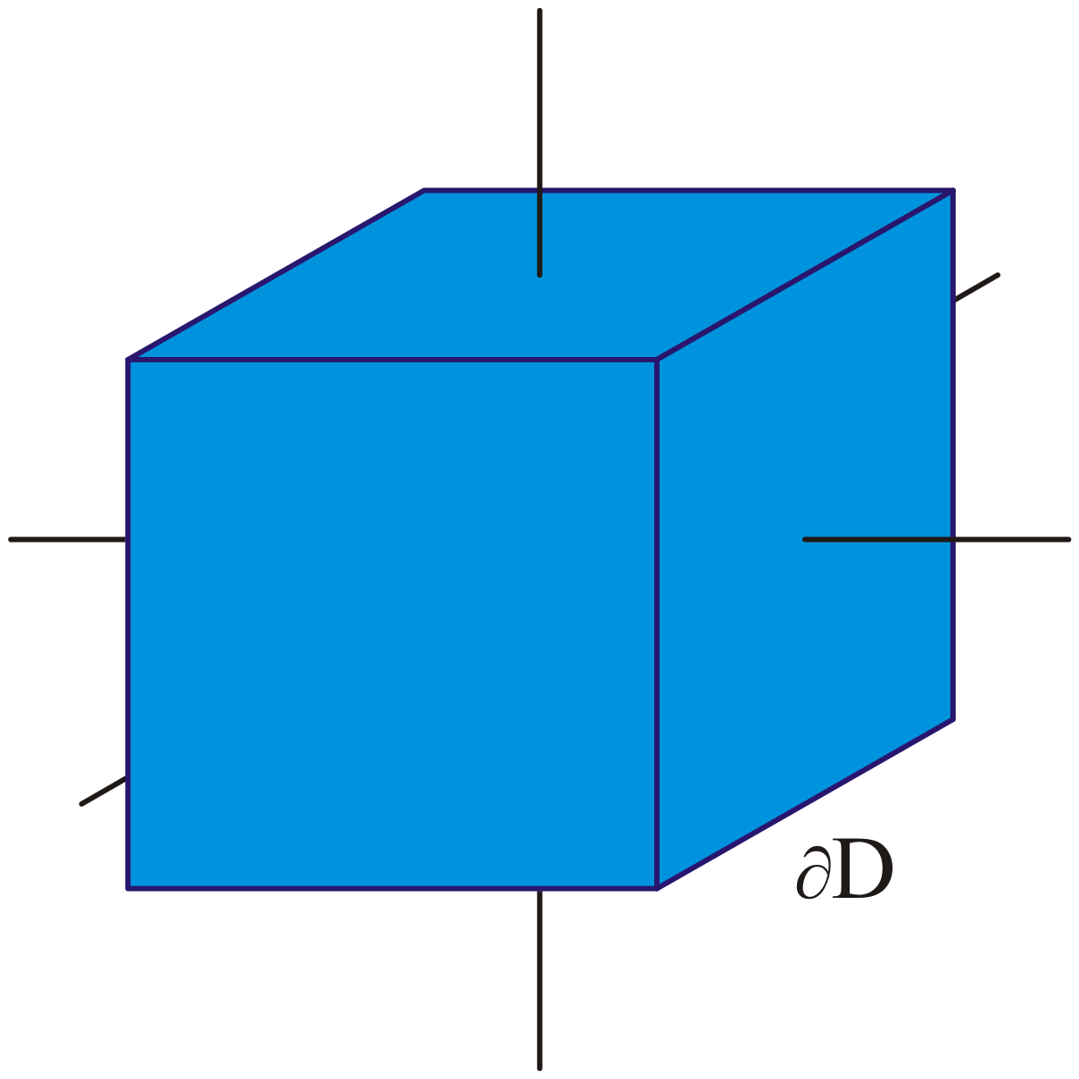
The Laplacian Operator
The boundary values must be specified on the entire boundary ∂D of the given domain

Slide 24
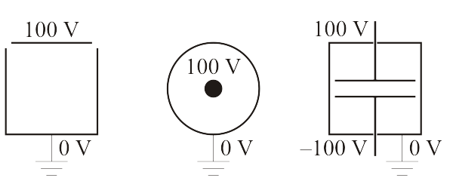
The Laplacian Operator
Examples of such constraints in two dimensions may be given by voltages
Note that constraints may also be internal as well as external

Slide 25
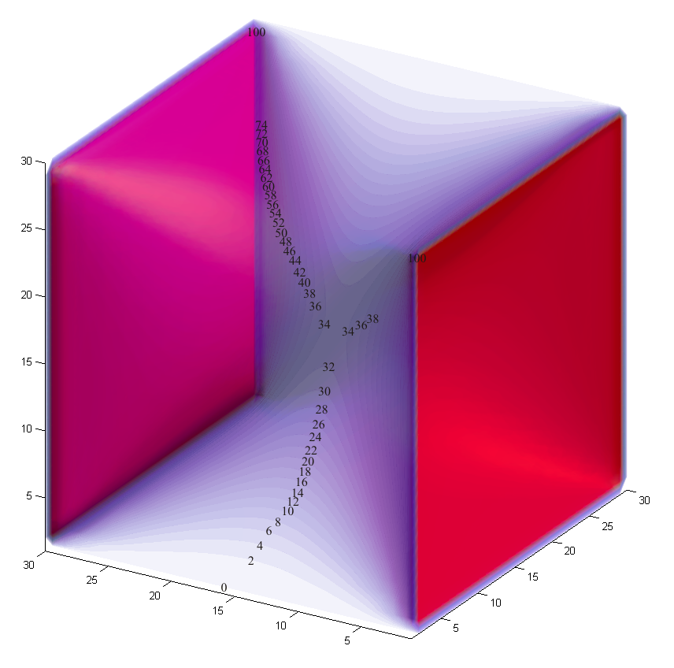
The Laplacian Operator
In three dimensions, if we have a cubic domain with two opposite sides at 100 ºC and the other four sides at 0 ºC, the potential inside the domain is shown here
At the centre of the cube, it is the average of the six sides: 33.3333 ºC

Slide 26
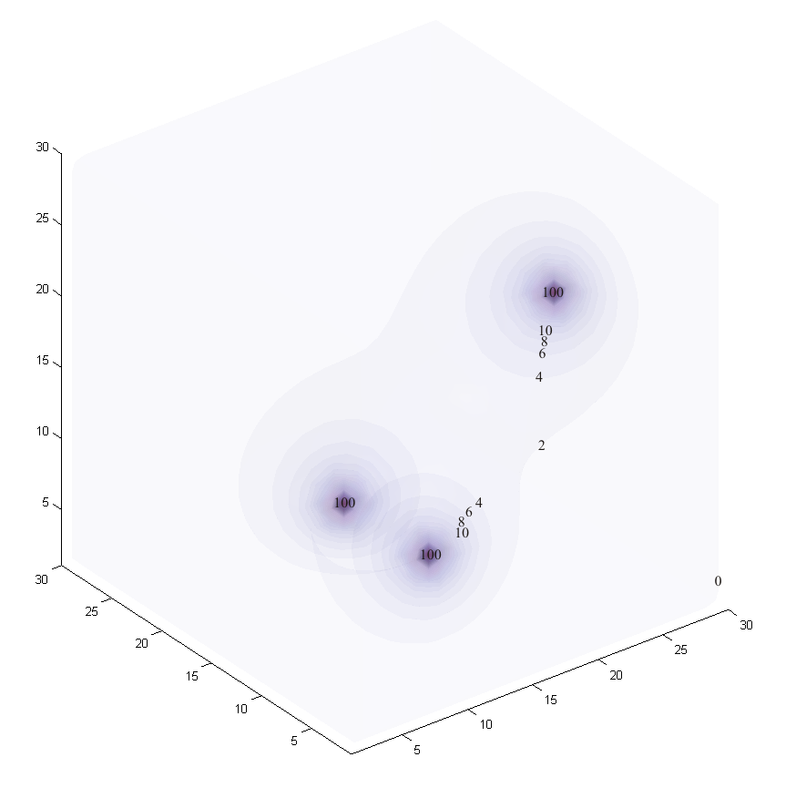
The Laplacian Operator
In three dimensions, if we have a cubic domain containing three heat sources at 100 ºC, and all sides at 0 ºC, the temperature throughout the room (assuming minimal convection) would be as shown

Slide 27
The Laplacian Operator
Given a closed wire frame, dipping the frame into a solution will produce a soap film
At each point, the concavities in the three directions will sum to zero
This fails for soap bubbles because Laplace’s equation isn’t satisfied: there is an external force—the force of the air inside the bubble pushing out
It is a sphere because that is the shape that satisfies Poisson’s equation

Slide 28
Approximating a Solution
In one dimension, when we solved BVPs, we divided the domain—the interval—into n equally spaced points
h

Slide 29
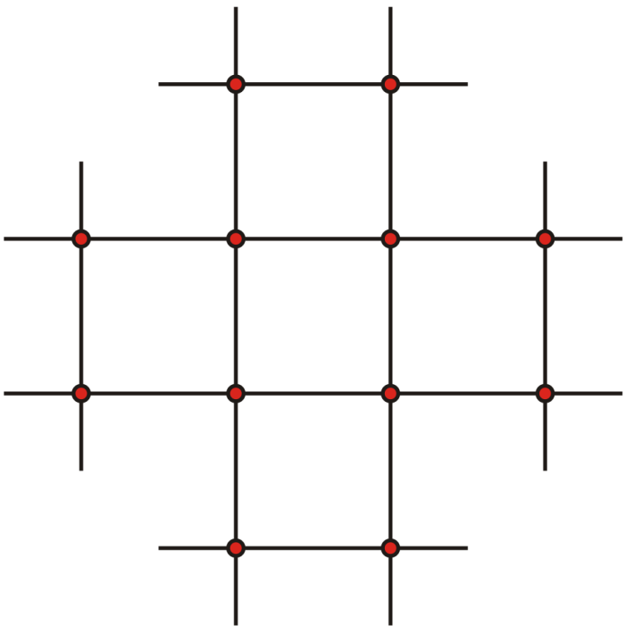
Approximating a Solution
In two dimensions, our finite-difference equation refers to points such as x + h and y – h; thus, this suggests a grid of points
h
h

Slide 30
Approximating a Solution
For simplicity, we will associate these variables:
x-dimension i_{x} ix
y-dimension i_{y} iy
z-dimension i_{z} iz
time dimension k k

Slide 31

Approximating a Solution
Thus, if we had a rectangular domain in two dimensions
The boundary conditions would be defined on the edge of the rectangle

Slide 32
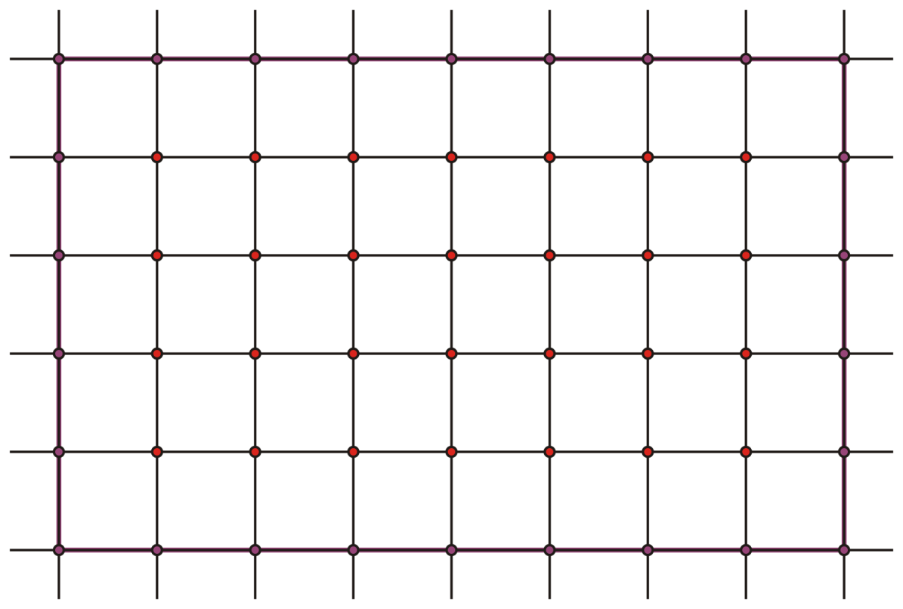
Approximating a Solution
We could overlay a grid of n_{x} × n_{y} points
We will assume h is identical in both dimensions
h
h

Slide 33
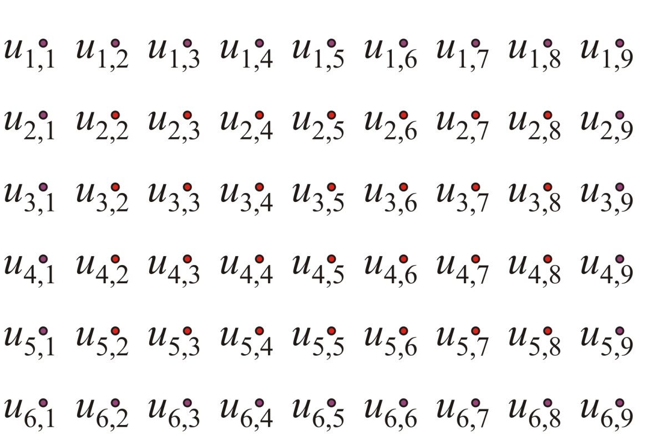
Approximating a Solution
This seems appropriate for a matrix:
U is an n_{x} × n_{y} matrix
The entry u_{i ,i} approximates the property at that location
_{x} _{y}

Slide 34
Approximating a Solution
We know the value of the boundary points

Slide 35
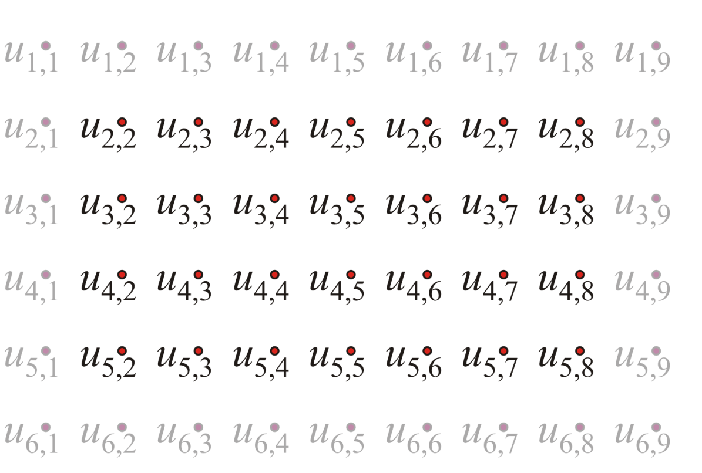
Approximating a Solution
Now we must approximate the values at the interior points

Slide 36
Approximating a Solution
Now we must approximate the values at the interior points
We will zoom in on one interior point:

Slide 37
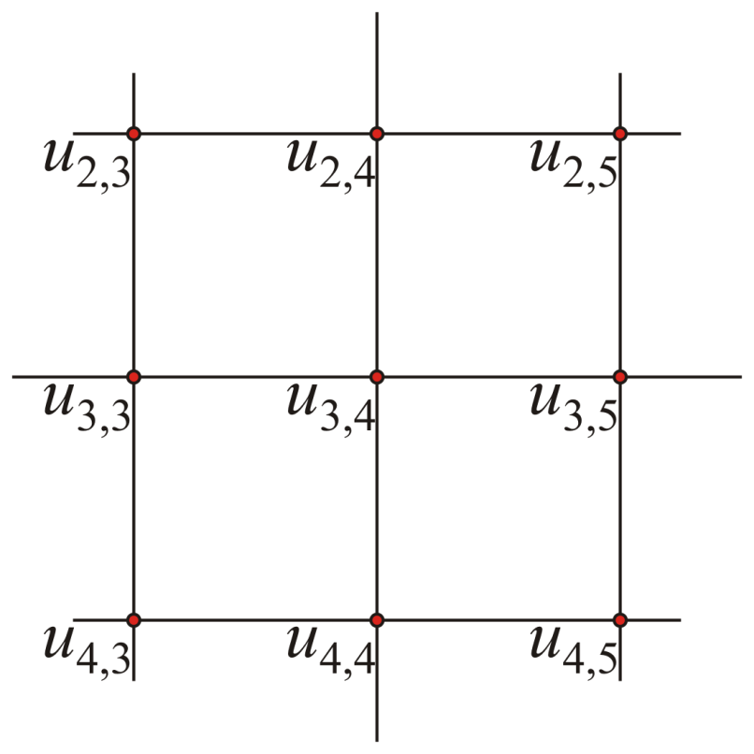
Approximating a Solution
Now we must approximate the values at the interior points
We will zoom in on one interior point:

Slide 38
Approximating a Solution
We could apply our finite-difference equation at this point:
Substitute x = x₃ and y = y₄ and rewrite the equation

Slide 39
Approximating a Solution
The simplified linear equation is
But

Slide 40
Approximating a Solution
The simplified linear equation is
Also, we approximate u(x_{i} , y_{i} ) ≈ u_{i ,i}
_{x}
_{y}
_{x}
_{y}

Slide 41
Approximating a Solution
The simplified linear equation is

Slide 42
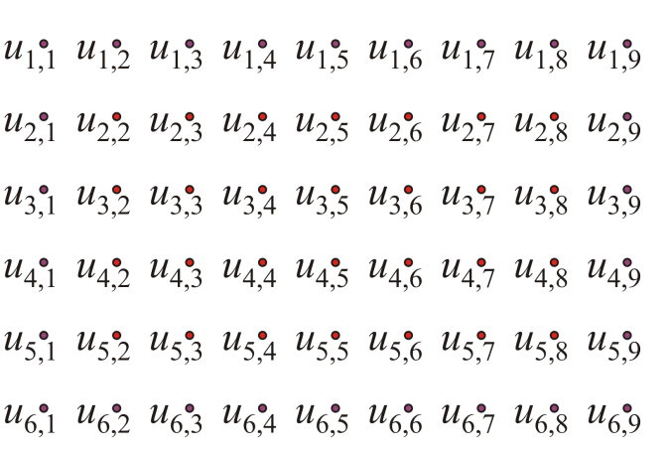
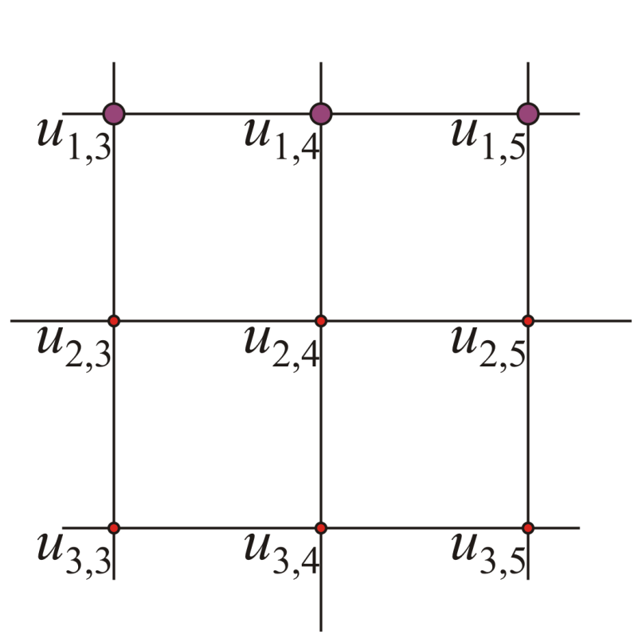
Approximating a Solution
What happens if some of the adjacent values are on the boundary?

Slide 43
Approximating a Solution
Recall that the boundary values are all given, thus, in this case, u_{1,4} is a given value

Slide 44
Approximating a Solution
Bring it to the other side…

Slide 45
Approximating a Solution
Thus, at each of the 28 interior points, we could write down a linear equation:

Slide 46
Approximating a Solution
Solve the system of equations, to get the approximate values at each of the interior points…

Slide 47
Approximating a Solution
This gives us 28 linear equations in 28 unknowns
All the boundary values must be known…

Slide 48
Approximating a Solution in 3 Dimensions
It wouldn’t be very different in three dimensions, either…

Slide 49
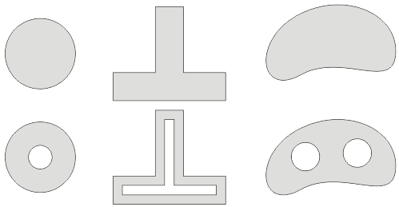
Irregular Domains
Grids are perfect if we are attempting to approximate a solution on a rectangular region
Most systems are not rectangular…
We can solve Laplace’s equation on any simply connected or contiguous domain

Slide 50
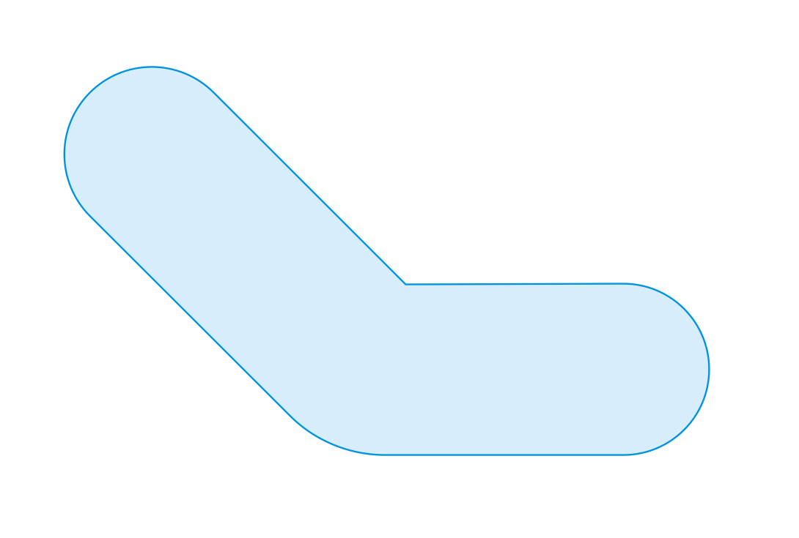
Irregular Domains
Suppose we have an irregular shape

Slide 51
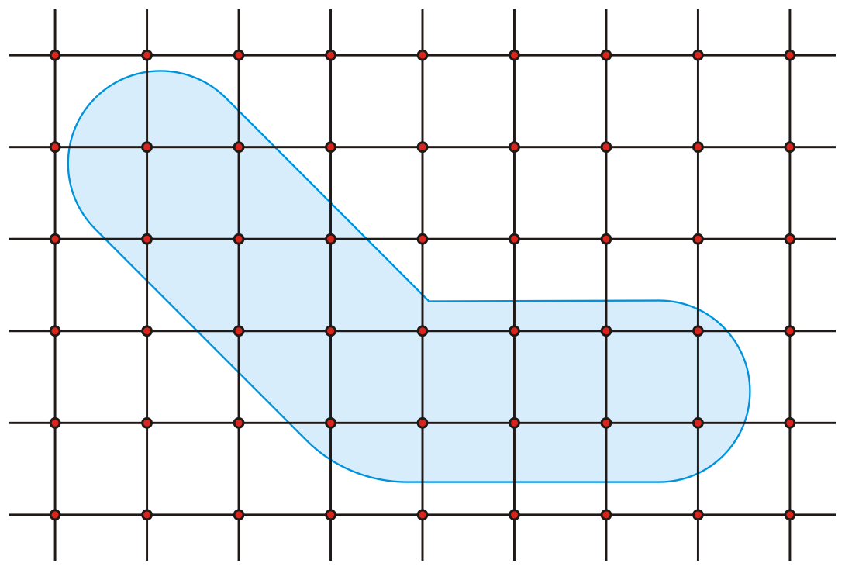
Irregular Domains
It may be possible to impose a grid on the shape

Slide 52

Irregular Domains
Those points outside the region would have to be specified

Slide 53

Irregular Domains
We could increase the number of points, but this may still be sub-optimal

Slide 54
Irregular Domains
We may have symmetries in one subdomain, but not in others

Slide 55
Finite Elements
An alternative techniques, pioneered by Alexander Hrennikoff (a civil engineer) and Richard Courant in the early 1940s
Finite elements allow the user to use tessellations
This divides the domain into triangular sub-domains in two dimensions or tetrahedral sub-domains in three dimensions
The Nanotechnology students will see the finite-element method in their 3B term

Slide 56
Initial and Boundary Conditions
When you consider this grid, there are 16 unknown points

Slide 57
Initial and Boundary Conditions
To create a system of linear equations, it’s necessary to label the points from 1 to 16 in some manner
w₁
w₂
w₃
w₄
w₅
w₆
w₇
w₈
w₉
w₁₀
w₁₁
w₁₂
w₁₃
w₁₄
w₁₅
w₁₆

Slide 58
Initial and Boundary Conditions
We will need a mapping between what we will call u-space and the w-space
w₁ ↔ u_{2,2} w₂ ↔ u_{2,3}
w₃ ↔ u_{3,2} w₄ ↔ u_{3,3}
w₅ ↔ u_{3,4} w₆ ↔ u_{4,3}
w₇ ↔ u_{4,4} w₈ ↔ u_{4,5}
w₉ ↔ u_{4,6} w₁₀ ↔ u_{4,7}
w₁₁ ↔ u_{4,8} w₁₂ ↔ u_{5,4}
w₁₃ ↔ u_{5,5} w₁₄ ↔ u_{5,6}
w₁₅ ↔ u_{5,7} w₁₆ ↔ u_{5,8}
w₁
w₂
u_{2,2}
u_{2,3}
w₃
w₄
w₅
u_{3,2}
u_{3,3}
u_{3,4}
w₆
w₇
w₈
w₉
w₁₀
w₁₁
u_{4,3}
u_{4,4}
u_{4,5}
u_{4,6}
u_{4,7}
u_{4,8}
w₁₂
w₁₃
w₁₄
w₁₅
w₁₆
u_{5,4}
u_{5,5}
u_{5,6}
u_{5,7}
u_{5,8}

Slide 59
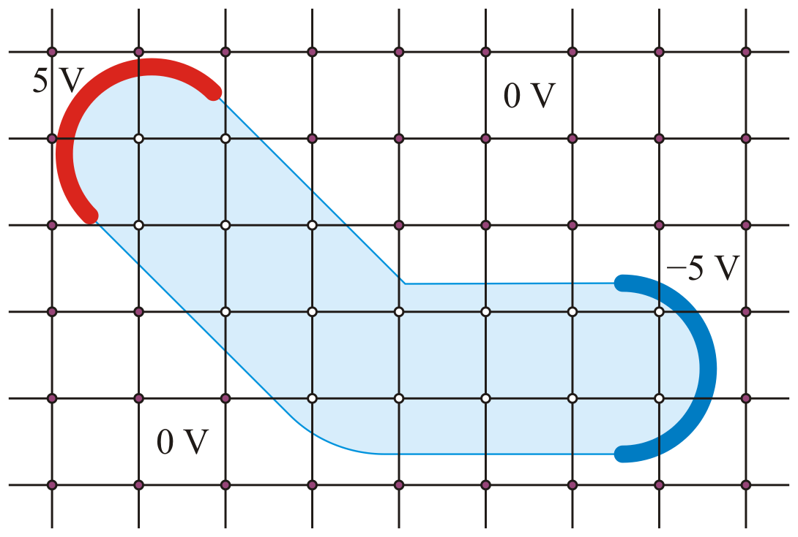
Boundary Conditions
Now, suppose the boundary conditions are:
±5 V at the ends and 0 V everywhere else

Slide 60

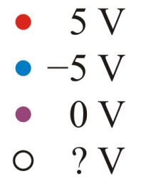
Boundary Conditions
Those points closest to these boundaries would be given the specified values

Slide 61
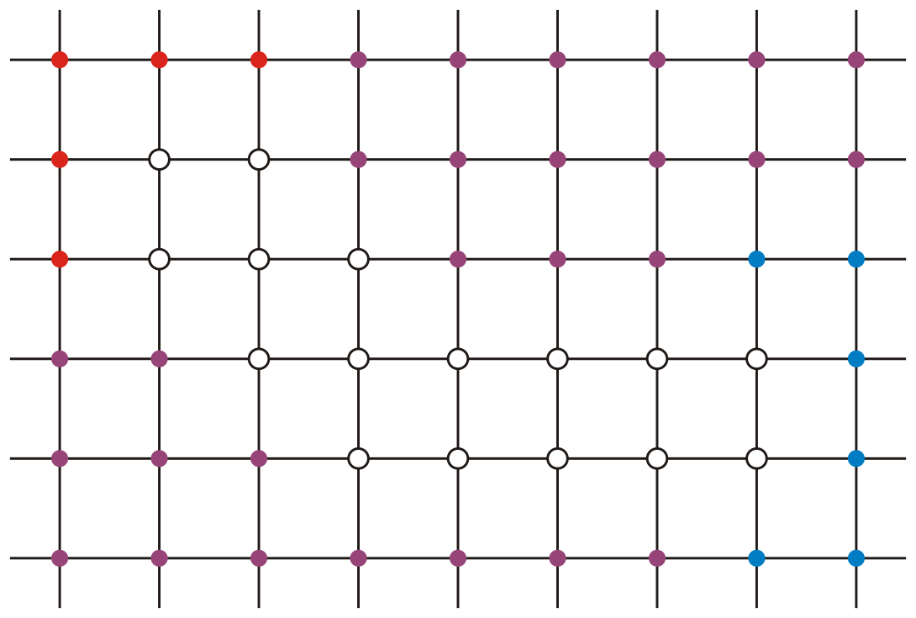
Approximating Solutions
Now we have a grid of points where each has either:
A specified value (the boundary values), or
Unknown values (what we will solve for)
w₁
w₂
w₃
w₄
w₅
w₆
w₇
w₈
w₉
w₁₀
w₁₁
w₁₂
w₁₃
w₁₄
w₁₅
w₁₆

Slide 62
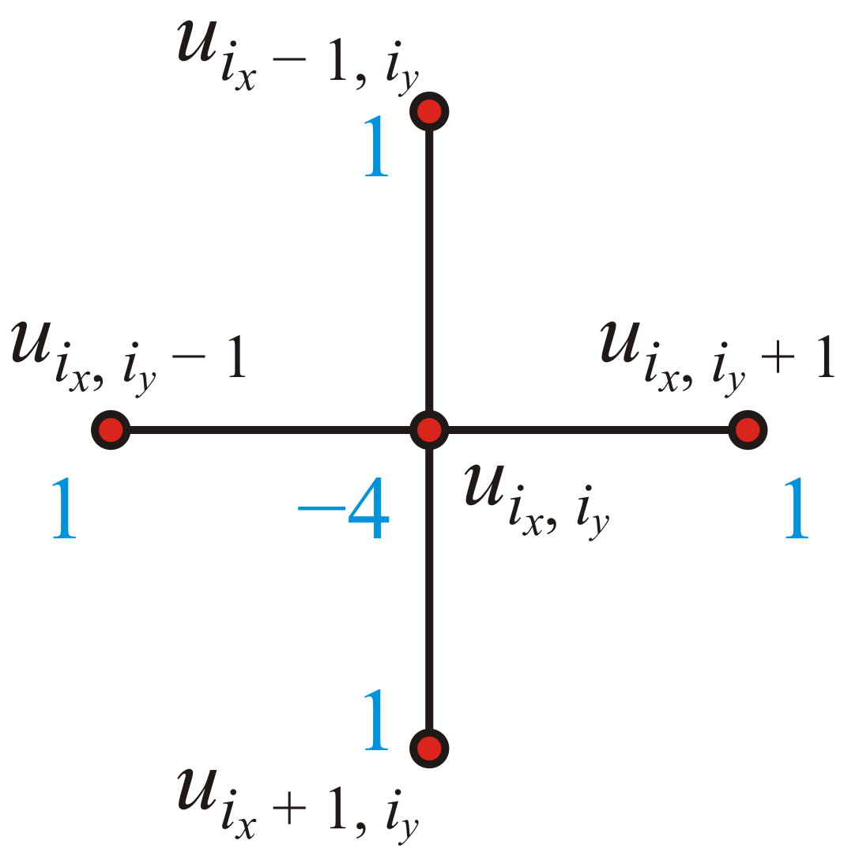
Approximating Solutions
At each unknown point, we apply the finite-difference equation
w₁
w₂
w₃
w₄
w₅
w₆
w₇
w₈
w₉
w₁₀
w₁₁
w₁₂
w₁₃
w₁₄
w₁₅
w₁₆

Slide 63
Approximating Solutions
We will zoom on the top left area
w₁
w₂
w₃
w₄
w₅
w₆
w₇
w₈
w₉
w₁₀
w₁₁
w₁₂
w₁₃
w₁₄
w₁₅
w₁₆

Slide 64
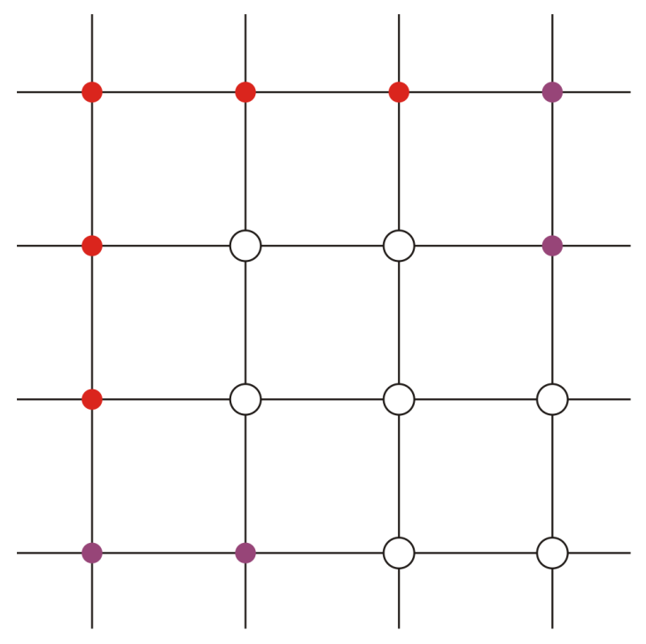

Approximating Solutions
Apply the equation at w₁:
5 V
5 V
w₁
w₂
w₃
w₄
w₅
w₆
w₇

Slide 65
Approximating Solutions
Apply the equation at w₂:
5 V
5 V
w₁
w₂
w₃
w₄
w₅
w₆
w₇

Slide 66
Approximating Solutions
Apply the equation at w₃:
5 V
5 V
w₁
w₂
w₃
w₄
w₅
w₆
w₇

Slide 67
Approximating Solutions
And apply the equation at w₄:
5 V
5 V
w₁
w₂
w₃
w₄
w₅
w₆
w₇

Slide 68
Approximating Solutions
This generates a system of 16 linear equations in 16 unknowns
w₁
w₂
w₃
w₄
w₅
w₆
w₇
w₈
w₉
w₁₀
w₁₁
w₁₂
w₁₃
w₁₄
w₁₅
w₁₆

Slide 69
Approximating Solutions
In matrix form, we have:

Slide 70
Approximating Solutions
Solving this in Matlab yields:

Slide 71
Approximating Solutions
Recall our initial designations of the 16 points:
w₁
w₂
w₃
w₄
w₅
w₆
w₇
w₈
w₉
w₁₀
w₁₁
w₁₂
w₁₃
w₁₄
w₁₅
w₁₆

Slide 72
Approximating Solutions
Substituting the values we determined yields:
3.78
2.57
2.57
1.49
0.42
0.42
0.18
–0.13
–0.52
–1.45
–3.82
0.00
–0.17
–0.54
–1.45
–3.82

Slide 73
Approximating Solutions
The electric potential we just approximated could be used to determine the path of a positive charge from the source to the sink
3.78
2.57
2.57
1.49
0.42
0.42
0.18
–0.13
–0.52
–1.45
–3.82
0.00
–0.17
–0.54
–1.45
–3.82

Slide 74
Approximating Insulated Boundaries
If a boundary is insulated, we will assume it has a value equal to its neighbour
We made similar assumptions by setting finite difference equations to zero

Slide 75
Approximating Insulated Boundaries
Suppose in our example, the base is insulated
Insulated

Slide 76
Approximating Insulated Boundaries
Apply the equation at w₂:
5 V
Insulated
5 V
w₁
w₂
w₃
w₄
w₅
w₆
w₇

Slide 77
Approximating Insulated Boundaries
Apply the equation at w₂:
5 V
Insulated
5 V
w₁
w₂
w₃
w₄
w₅
w₆
w₇

Slide 78
Approximating Insulated Boundaries
Apply the equation at w₃:
5 V
Insulated
5 V
w₁
w₂
w₃
w₄
w₅
w₆
w₇

Slide 79
Approximating Insulated Boundaries
Apply the equation at w₃:
5 V
Insulated
5 V
w₁
w₂
w₃
w₄
w₅
w₆
w₇

Slide 80
Approximating Insulated Boundaries
This gives a system of 16 linear equations in 16 unknowns
Insulated
w₁
w₂
w₃
w₄
w₅
w₆
w₇
w₈
w₉
w₁₀
w₁₁
w₁₂
w₁₃
w₁₄
w₁₅
w₁₆

Slide 81
Approximating Insulated Boundaries
The only entries that changed are those on the diagonal:

Slide 82
Approximating Insulated Boundaries
Solving this in Matlab yields:

Slide 83
Approximating Insulated Boundaries
Recall our initial designations of the 16 points:
w₁
w₂
Insulated
w₃
w₄
w₅
w₆
w₇
w₈
w₉
w₁₀
w₁₁
w₁₂
w₁₃
w₁₄
w₁₅
w₁₆

Slide 84
Approximating Insulated Boundaries
Substituting the values we determined yields:
4.61
4.22
Insulated
4.22
3.05
1.87
1.87
0.70
–0.78
–2.04
–3.23
–4.41
– 0.15
–1.01
–2.10
–3.25
–4.42

Slide 85
Approximating Insulated Boundaries
The transition is much more gradual with insulated boundaries
4.61
4.22
4.22
3.05
1.87
1.87
0.70
–0.78
–2.04
–3.23
–4.41
– 0.15
–1.01
–2.10
–3.25
–4.42
3.78
2.57
2.57
1.49
0.42
0.42
0.18
–0.13
–0.52
–1.45
–3.82
Insulated
0.00
–0.17
–0.54
–1.45
–3.82

Slide 86
Specifying Boundary Conditions
How do we create such a system of linear equations?
First we must allow the user to specify boundary conditions
The user will pass in a matrix
Boundary values will be already specified
Insulated boundaries are marked with NaN
Points at which we want to approximate the solution are assigned –∞

Slide 87
Specifying Boundary Conditions
In our first example, the boundary would be specified by:
>> M = [5 5 5 0 0 0 0 0 0
5 -Inf -Inf 0 0 0 0 0 0
5 -Inf -Inf -Inf 0 0 0 -5 -5
0 0 -Inf -Inf -Inf -Inf -Inf -Inf -5
0 0 0 -Inf -Inf -Inf -Inf -Inf -5
0 0 0 0 0 0 0 -5 -5];

Slide 88
Specifying Boundary Conditions
In our second example, they would be specified by:
>> M = [5 5 5 NaN NaN NaN NaN NaN NaN
5 -Inf -Inf NaN NaN NaN NaN NaN NaN
5 -Inf -Inf -Inf NaN NaN NaN -5 -5
NaN NaN -Inf -Inf -Inf -Inf -Inf -Inf -5
NaN NaN NaN -Inf -Inf -Inf -Inf -Inf -5
NaN NaN NaN NaN NaN NaN NaN -5 -5];
Insulated

Slide 89
Approximating the Solution
The first step is argument checking:
Ensure that none of the points on the edge of the array are –∞
There must be a boundary value (fixed or insulated) around the entire array
>> M = [5 5 5 NaN NaN NaN NaN NaN NaN
5 -Inf -Inf NaN NaN NaN NaN NaN NaN
5 -Inf -Inf -Inf NaN NaN NaN -5 -5
NaN NaN -Inf -Inf -Inf -Inf -Inf -Inf -5
NaN NaN NaN -Inf -Inf -Inf -Inf -Inf -5
NaN NaN NaN NaN NaN NaN NaN -5 -5];

Slide 90
Approximating the Solution
The second and third steps are initialization and mapping each of the m unsolved points to a unique number from 1 to m

Slide 91
Approximating the Solution
These steps are done for you:
function [U_out] = laplace2d( U )
% 2. Initialization
[n_x, n_y] = size( U );
U_out = U;
% 3. Associate each -Inf with an integer from 1 to m
u_to_w = zeros( n_x, n_y );
w_to_u = zeros( 2, n_x * n_y );
m = 0;
for ix = 1:n_x
for iy = 1:n_y
if U(ix, iy) == -Inf
m = m + 1;
u_to_w(ix, iy) = m;
w_to_u(:, m) = [ix, iy]';
end
end
end

Slide 92
Approximating the Solution
Step 4 creates and solves the system of linear equations
function [U_out] = laplace2d( U )
% 2. Initialization
[n_x, n_y] = size( U );
U_out = U;
% 3. Associate each -Inf with an integer from 1 to m
u_to_w = zeros( n_x, n_y );
w_to_u = zeros( 2, n_x * n_y );
m = 0;
for ix = 1:n_x
for iy = 1:n_y
if U(ix, iy) == -Inf
m = m + 1;
u_to_w(ix, iy) = m;
w_to_u(:, m) = [ix, iy]';
end
end
end
% Create the sparse system of linear equations
M = spalloc( m, m, 5*m );
b = zeros( m, 1 );

Slide 93
Creating the System of Linear Equations
Suppose we have:
>> U = [5 5 5 5 5; NaN -Inf -Inf -Inf 1; NaN -Inf 9 -Inf 1; 1 1 1 1 1]
U =
5 5 5 5 5
NaN -Inf -Inf -Inf 1
NaN -Inf 9 -Inf 1
1 1 1 1 1
After running Step 3, the variables are assigned:
m =
5
u_to_w =
0 0 0 0 0
0 1 2 3 0
0 4 0 5 0
0 0 0 0 0
w_to_u =
2 2 2 3 3 ...
2 3 4 2 4 ...

Slide 94
Creating the System of Linear Equations
The next step, Step 4, involves us creating and solving the system of linear equations
We begin by creating the appropriately sized matrices and vectors:
>> M = zeros( m, m )
M =
0 0 0 0 0
0 0 0 0 0
0 0 0 0 0
0 0 0 0 0
0 0 0 0 0
>> b = zeros( m, 1 )
b =
0
0
0
0
0

Slide 95
Creating the System of Linear Equations
How do we update M and b?

Slide 96
Approximating the Solution
Focusing on the first point 1, we note that it is at
>> c = w_to_u(:, 1)
c =
2
2
U =
5 5 5 5 5
NaN -Inf -Inf -Inf 1
NaN -Inf 9 -Inf 1
1 1 1 1 1
w_to_u =
2 2 2 3 3 ...
2 3 4 2 4 ...
M =
0 0 0 0 0
0 0 0 0 0
0 0 0 0 0
0 0 0 0 0
0 0 0 0 0
b =
0
0
0
0
0
u_to_w =
0 0 0 0 0
0 1 2 3 0
0 4 0 5 0
0 0 0 0 0

Slide 97
Approximating the Solution
Focusing on the first point 1, we note that it is at
>> c = w_to_u(:, 1)
c =
2
2
The neighbouring points are at
c + [-1 0]';
c + [ 1 0]';
c + [ 0 -1]';
c + [ 0 1]';
U =
5 5 5 5 5
NaN -Inf -Inf -Inf 1
NaN -Inf 9 -Inf 1
1 1 1 1 1
w_to_u =
2 2 2 3 3 ...
2 3 4 2 4 ...
M =
0 0 0 0 0
0 0 0 0 0
0 0 0 0 0
0 0 0 0 0
0 0 0 0 0
b =
0
0
0
0
0
u_to_w =
0 0 0 0 0
0 1 2 3 0
0 4 0 5 0
0 0 0 0 0

Slide 98
Approximating the Solution
Given the i^{th} unknown point, if a neighbouring point is:
An insulated boundary (NaN):
Do nothing!
A Dirichlet boundary condition:
Subtract 1 from the i^{th} diagonal entry of M, and
Subtract the value from the i^{th} entry of the vector b
Another unknown (-Inf) point (say the j^{th} unknown)
Subtract 1 from the i^{th} diagonal entry of M, and
Add 1 to the (i, j)^{th} entry of M

Slide 99
Approximating the Solution
Focusing on the first point 1, we note that it is at
>> c = w_to_u(:, 1)
c =
2
2
The first point is 5 and not –∞: update M and b
>> p = c + [-1 0]';
p =
1
2
>> U(p(1), p(2))
ans =
5
U =
5 5 5 5 5
NaN -Inf -Inf -Inf 1
NaN -Inf 9 -Inf 1
1 1 1 1 1
w_to_u =
2 2 2 3 3 ...
2 3 4 2 4 ...
u_to_w =
0 0 0 0 0
0 1 2 3 0
0 4 0 5 0
0 0 0 0 0
M =
-1 0 0 0 0
0 0 0 0 0
0 0 0 0 0
0 0 0 0 0
0 0 0 0 0
b =
-5
0
0
0
0

Slide 100
Approximating the Solution
Focusing on the first point 1, we note that it is at
>> c = w_to_u(:, 1)
c =
2
2
The second point is –∞: update M
>> p = c + [ 1 0]';
p =
3
2
>> u_to_w(p(1), p(2))
ans =
4
U =
5 5 5 5 5
NaN -Inf -Inf -Inf 1
NaN -Inf 9 -Inf 1
1 1 1 1 1
w_to_u =
2 2 2 3 3 ...
2 3 4 2 4 ...
u_to_w =
0 0 0 0 0
0 1 2 3 0
0 4 0 5 0
0 0 0 0 0
M =
-2 0 0 1 0
0 0 0 0 0
0 0 0 0 0
0 0 0 0 0
0 0 0 0 0
b =
-5
0
0
0
0

Slide 101
Approximating the Solution
Focusing on the first point 1, we note that it is at
>> c = w_to_u(:, 1)
c =
2
2
The third point is NaN: do nothing...
>> p = c + [ 0 -1]';
p =
2
1
U =
5 5 5 5 5
NaN -Inf -Inf -Inf 1
NaN -Inf 9 -Inf 1
1 1 1 1 1
w_to_u =
2 2 2 3 3 ...
2 3 4 2 4 ...
u_to_w =
0 0 0 0 0
0 1 2 3 0
0 4 0 5 0
0 0 0 0 0
M =
-2 0 0 1 0
0 0 0 0 0
0 0 0 0 0
0 0 0 0 0
0 0 0 0 0
b =
-5
0
0
0
0

Slide 102
Approximating the Solution
Focusing on the first point 1, we note that it is at
>> c = w_to_u(:, 1)
c =
2
2
The fourth point is –∞: update M
>> p = c + [ 0 1]';
p =
2
3
>> u_to_w(p(1), p(2))
ans =
2
U =
5 5 5 5 5
NaN -Inf -Inf -Inf 1
NaN -Inf 9 -Inf 1
1 1 1 1 1
w_to_u =
2 2 2 3 3 ...
2 3 4 2 4 ...
u_to_w =
0 0 0 0 0
0 1 2 3 0
0 4 0 5 0
0 0 0 0 0
M =
-3 1 0 1 0
0 0 0 0 0
0 0 0 0 0
0 0 0 0 0
0 0 0 0 0
b =
-5
0
0
0
0

Slide 103
Approximating the Solution
Performing this on all m unknown entries, we have the matrix M and the vector b:
U =
5 5 5 5 5
NaN -Inf -Inf -Inf 1
NaN -Inf 9 -Inf 1
1 1 1 1 1
M =
-3 1 0 1 0
1 -4 1 0 0
0 1 -4 0 1
1 0 0 -3 0
0 0 1 0 -4
b =
-5
-14
-6
-10
-11

Slide 104
Approximating the Solution
Solving the system Mu = b yields
U =
5 5 5 5 5
NaN -Inf -Inf -Inf 1
NaN -Inf 9 -Inf 1
1 1 1 1 1
M =
-3 1 0 1 0
1 -4 1 0 0
0 1 -4 0 1
1 0 0 -3 0
0 0 1 0 -4
b =
-5
-14
-6
-10
-11
>> u = M \ b
u =
5.2978
5.7940
3.8784
5.0993
3.7196

Slide 105
Approximating the Solution
Step 5 has us substitute these values back into U_{out}:
U =
5 5 5 5 5
NaN -Inf -Inf -Inf 1
NaN -Inf 9 -Inf 1
1 1 1 1 1
M =
-3 1 0 1 0
1 -4 1 0 0
0 1 -4 0 1
1 0 0 -3 0
0 0 1 0 -4
b =
-5
-14
-6
-10
-11
>> u = M \ b
u =
5.2978
5.7940
3.8784
5.0993
3.7196
U_out =
5.0000 5.0000 5.0000 5.0000 5.0000
NaN 5.2978 5.7940 3.8784 1.0000
NaN 5.0993 9.0000 3.7196 1.0000
1.0000 1.0000 1.0000 1.0000 1.0000
w_to_u =
2 2 2 3 3 ...
2 3 4 2 4 ...

Slide 106
Approximating the Solution
We will leave the NaN unchanged in the solution matrix...
U =
5 5 5 5 5
NaN -Inf -Inf -Inf 1
NaN -Inf 9 -Inf 1
1 1 1 1 1
M =
-3 1 0 1 0
1 -4 1 0 0
0 1 -4 0 1
1 0 0 -3 0
0 0 1 0 -4
b =
-5
-14
-6
-10
-11
>> u = M \ b
u =
5.2978
5.7940
3.8784
5.0993
3.7196
U_out =
5.0000 5.0000 5.0000 5.0000 5.0000
NaN 5.2978 5.7940 3.8784 1.0000
NaN 5.0993 9.0000 3.7196 1.0000
1.0000 1.0000 1.0000 1.0000 1.0000
w_to_u =
2 2 2 3 3 ...
2 3 4 2 4 ...

Slide 107
Approximating the Solution
Step 4 is to create and solve the system of linear equations
% Create the sparse system of linear equations
M = spalloc( m, m, 5*m );
b = zeros( m, 1 );
for j = 1:m
% Get the coordinates of the kth point
% For each of the 4 (6 for 3D) adjacent points, determine if the point
% is an insluated boundary point, a Dirichlet boundary point or an
% unknown value and modify M as appropriate.
end
w = M \ b;
for j = 1:m
% Copy the value from w into U_out
end

Slide 108

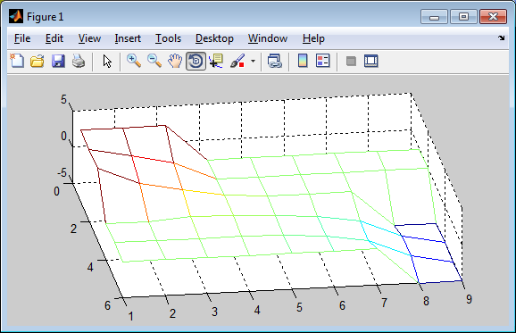
Another Example
If you want to attempt to solve the first problem, use:
U5a = zeros( 6, 9 );
U5a( 1:3, 1:3 ) = 5;
U5a( 3:6, 8:9 ) = -5;
U5a( 2:3, 2:3 ) = -Inf;
U5a( 3:4, 3:4 ) = -Inf;
U5a( 4:5, 4:8 ) = -Inf;
U5a_soln = laplace2d( U5a )
mesh( U5a_soln' )
3.78
2.57
2.57
1.49
0.42
0.42
0.18
–0.13
–0.52
–1.45
–3.82
0.00
–0.17
–0.54
–1.45
–3.82

Slide 109
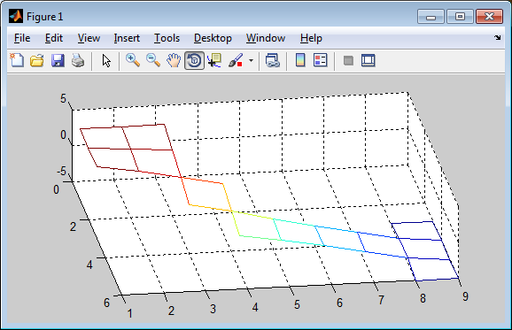
Another Example
If you want to attempt to solve the second problem, use:
U5b = NaN*ones( 6, 9 );
U5b( 1:3, 1:3 ) = 5;
U5b( 3:6, 8:9 ) = -5;
U5b( 2:3, 2:3 ) = -Inf;
U5b( 3:4, 3:4 ) = -Inf;
U5b( 4:5, 4:8 ) = -Inf;
U5b_soln = laplace2d( U5b )
mesh( U5b_soln' )
4.61
4.22
4.22
3.05
1.87
1.87
0.70
–0.78
–2.04
–3.23
–4.41
–0.15
1.01
–2.10
3.25
–4.42
Insulated

Slide 110
Solutions in 3D
Your function lapace3d will take a 3D array as an argument and it will fill in any entries that are -Inf.
To plot such objects, the function isosurf will take such a 3D array and
isosurf( U_out, 30 )
will plot thirty surfaces from the highest value to the lowest

Slide 111
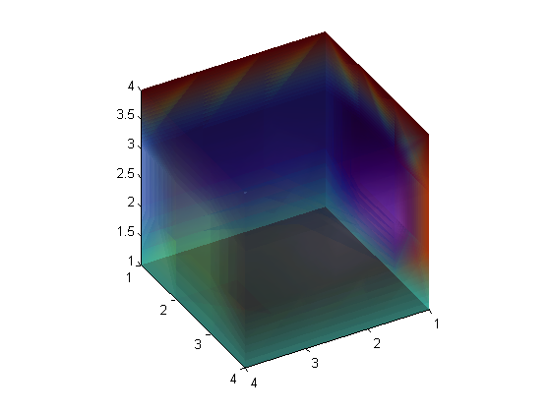
Solutions in 3D
U4c_soln(:,:,1) =
3 3 3 3
3 3 3 3
3 3 3 3
3 3 3 3
U4c_soln(:,:,2) =
2 1 1 5
2 2.6 3.2 5
2 3.2 3.8 5
2 4 4 5
U4c_soln(:,:,3) =
2 1 1 5
2 3.2 3.8 5
2 3.8 4.4 5
2 4 4 5
U4c_soln(:,:,4) =
6 6 6 6
6 6 6 6
6 6 6 6
6 6 6 6
U4c = -Inf*ones( 4, 4, 4 );
U4c( 1 , : , : ) = 1;
U4c(end, : , : ) = 4;
U4c( : , 1 , : ) = 2;
U4c( : , end, : ) = 5;
U4c( : , : , 1 ) = 3;
U4c( : , : , end) = 6;
U4c_soln = laplace3d( U4c )
isosurf( U4c_soln, 21 )
Note: colours may vary...

Slide 112
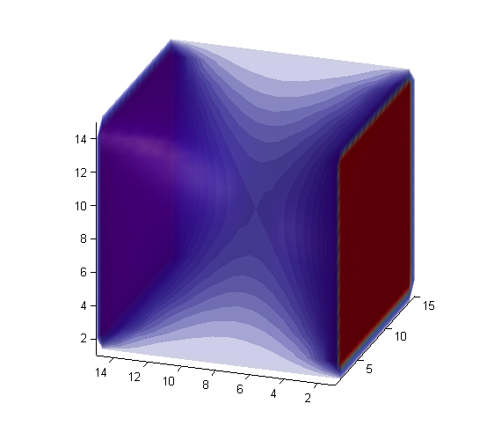
Solutions in 3D
U4d = -Inf*ones( 15, 15, 15 );
U4d([1, end], : , :) = 100;
U4d(:, [1, end], :) = 0;
U4d(:, :, [1, end]) = 0;
U4d_soln = laplace3d( U4d )
isosurf( U4d_soln, 21 )
Note: isosurf is available for download in the Laboratory directory
Note: colours may vary...

Slide 113
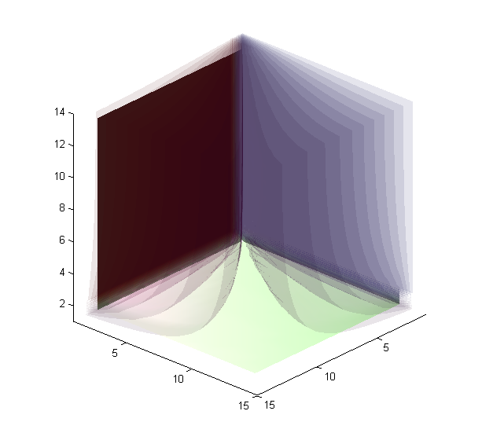
Solutions in 3D
U4e = -Inf*ones( 15, 15, 15 );
U4e( 1 , : , : ) = 100;
U4e(end, : , : ) = NaN;
U4e( : , 1 , : ) = 0;
U4e( : , end, : ) = NaN;
U4e( : , : , 1 ) = 50;
U4e( : , : , end) = NaN;
U4e_soln = laplace3d( U4e )
isosurf( U4e_soln, 21 )
100
0
50
Note: colours may vary...

Slide 114
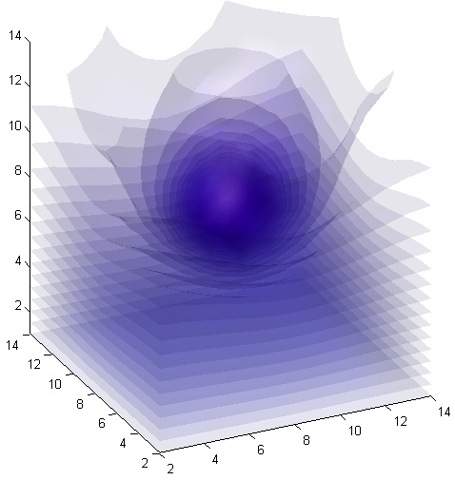
Solutions in 3D
U4f = -Inf*ones( 15, 15, 15 );
U4f([1, end], :, :) = NaN;
U4f(:, [1, end], :) = NaN;
U4f(:, :, 1) = 0;
U4f(:, :, end) = NaN;
U4f(8, 8, 8) = 100;
U4f_soln = laplace3d( U4f )
isosurf( U4f_soln, 100 )
16
33
10
Note: colours may vary...

Slide 115
Laboratory 5
During the laboratory, you will implement two functions:
lapace2d and laplace3d
Once you have lapace2d working, laplace3d will require only a few modifications

Slide 116
Steps to the Problem
Thus, the steps are:
Argument checking
Initialization
Mapping the unknown points to a unique number from 1 to m
Creating and solving the system of linear equations
Substituting these values back into the solution

Slide 117
Useful Matlab Commands
Note the behaviour of for-loops in Matlab when the argument being iterated over is a matrix:
>> for v = [0 0 1 1; 0 1 0 1]
v
end
v =
0
0
v =
0
1
v =
1
0
v =
1
1

Slide 118
Useful Matlab Commands
As another example, consider:
>> for v = [1 2 3; 4 5 6; 7 8 9]
v
end
v =
1
4
7
v =
2
5
8
v =
3
6
9

Slide 119
Useful Matlab Commands
It is possible to create grids in higher dimensions:
>> M = zeros( 4, 5, 3 )
M(:, :, 1) =
0 0 0 0 0
0 0 0 0 0
0 0 0 0 0
0 0 0 0 0
M(:, :, 2) =
0 0 0 0 0
0 0 0 0 0
0 0 0 0 0
0 0 0 0 0
M(:, :, 3) =
0 0 0 0 0
0 0 0 0 0
0 0 0 0 0
0 0 0 0 0

Slide 120
Useful Matlab Commands
Other functions work as expected:
>> size( M )
ans =
4 5 3

Slide 121
Useful Matlab Commands
Matrices indexed by more than two indices have their dimensions checked using ndims:
>> ndims( M )
ans =
3
>> ndims( 1 )
ans =
2
>> ndims( [1 2 3] )
ans =
2
>> ndims( [1 2 3 4; 5 6 7 8] )
ans =
2

Slide 122
Useful Matlab Commands
Sparse matrices are matrices that are mostly zero...
Sparse matrices may be allocated with spalloc:
>> M = spalloc( 1000, 1000, 5000 );
This:
Assumes the matrix will be 1000 × 1000
It will reserve memory for 5000 non-zero entries
The internal representation is all that changes: everything else is essentially the same

Slide 123
Useful Matlab Commands
Outside the display, everything else is the same:
M = spalloc( 5, 5, 12 );
M(1, 1) = 4; M(2, 2) = 7; M(3, 3) = 4; M(4, 4) = 8; M(5, 5) = 9; M(2, 1) = -3; M(3, 2) = -1; M(5, 4) = -2; M(1, 2) = -2; M(2, 3) = -1; M(3, 4) = -2; M(4, 5) = -3;
M
M =
(1,1) 4
(2,1) -3
(1,2) -2
(2,2) 7
(3,2) -1
(2,3) -1
(3,3) 4
(3,4) -2
(4,4) 8
(5,4) -2
(4,5) -3
(5,5) 9
M \ [1 2 3 4 5]'
ans =
0.6201
0.7403
1.3214
0.7727
0.7273
M = zeros( 5, 5 );
M(1, 1) = 4; M(2, 2) = 7; M(3, 3) = 4; M(4, 4) = 8;
M(5, 5) = 9; M(2, 1) = -3; M(3, 2) = -1; M(5, 4) = -2;
M(1, 2) = -2; M(2, 3) = -1; M(3, 4) = -2; M(4, 5) = -3;
M
M =
4 -2 0 0 0
-3 7 -1 0 0
0 -1 4 -2 0
0 0 0 8 -3
0 0 0 -2 9
M \ [1 2 3 4 5]'
ans =
0.6201
0.7403
1.3214
0.7727
0.7273

Slide 124
Summary
We have looked at solving Laplace’s equation
Considered the physical problem for Laplace’s equation
Considered the effects in two and three dimensions
Found a finite-difference equation approximating Laplace’s equation in both two and three dimensions
We find those points that are unknown: 1, …, m
We set up the system of equations
We solve the system of equations and substitute the values back into the matrix

Slide 125
References
[1] Glyn James, Modern Engineering Mathematics, 4th Ed., Prentice Hall, 2007, p.778.
[2] Glyn James, Advanced Modern Engineering Mathematics, 4th Ed., Prentice Hall, 2011, p.164.

